Slide 1
WTWY
Street Team
Deployment Analysis
Emily Geller
Brian McMahon

Slide 2
Scenario and Assumptions
Optimize WTWY street team placement
Street teams - modest headcount
Gala in early Summer
Notes:
EG
Tasked with optimizing WTWY street team placement for raising awareness of upcoming gala
Utilized NYC MTA and demographic data to perform analysis on areas with high traffic and favorable demographics

Slide 3
Process - MTA Turnstile Data Analysis
Import data
Clean data
Adjust turnstile data for daily increments
Filter outliers (ie > 99% quantile)
Sort by traffic
Plot time series of busiest stations
Notes:
BM
First of two part analysis: MTA Turnstile, and then demographic, data

Slide 4
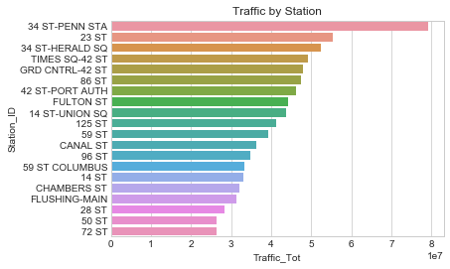
MTA Findings
Top NYC Subway Stations by Traffic
Heaviest traffic in central hubs
Will further vet outliers in subsequent analysis
Station
Traffic (10 millions)

Slide 5
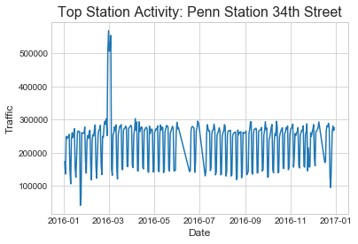
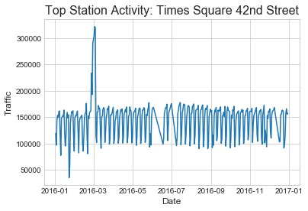
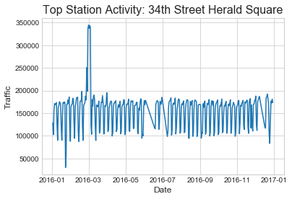
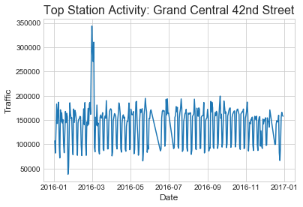
MTA Findings
Data consistent by week and station
Weekend dip
To investigate March spike

Slide 6
Process - Demographic Data
Using American Community Survey, analyzed demographics of busiest stations
Combined with census location data
Zoomed in on highest traffic stations and close proximity to analyze average demographics
We used mapping functionality found here to map demographics
Notes:
EG

Slide 7
Demographic Target
High income
High female population
High % use the NYC Subway
Business / tech hubs

Slide 8
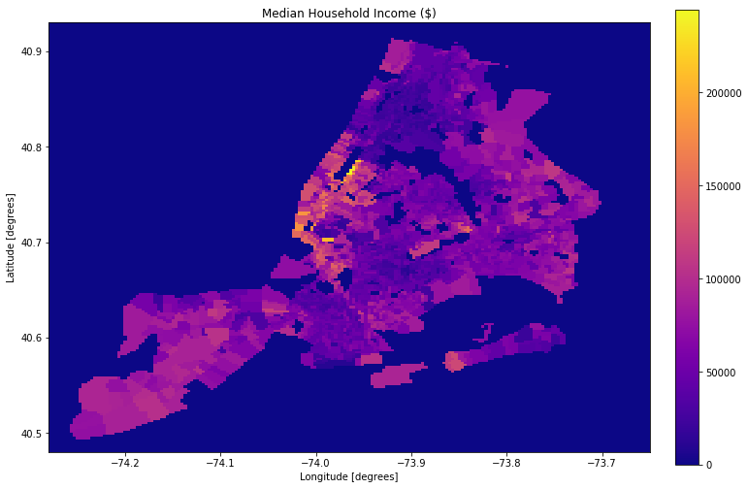
Median Household Income ($)
#7
42 St Port Auth
$82361
#10
125 St
$19045
#3
34 Herald Sq
$103264
#1
34 Penn St
$159821
#6
86 St
$97632
#2
23 St
$135750
Income
#8
Fulton St
$133209
#4
Grand Central-42 St
$122379
#9
14 St-Union Sq
$168375
#5
Times Sq-42 St
$82361

Slide 9
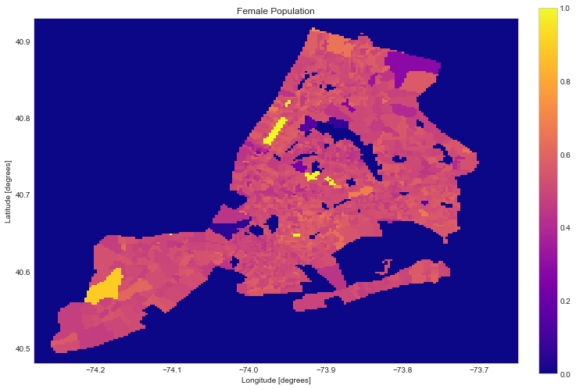
Female Percentage of Population
#7
42 St Port Auth
23.8%
#10
125 St
51.3%
#3
34 Herald Sq
55.9%
#1
34 Penn St
39.8%
#6
86 St
57.6%
#2
23 St
60.8%
Female Population %
#8
Fulton St
50.3%
#4
Grand Central-42 St
52.1%
#9
14 St-Union Sq
51.0%
#5
Times Sq-42 St
23.8%

Slide 10
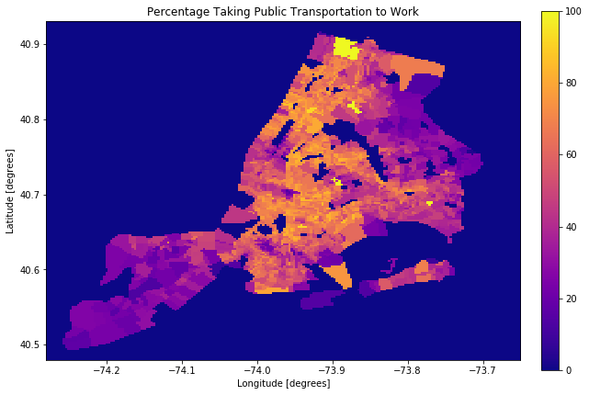
Percentage of Population taking Public Transport to Work
#7
42 St Port Auth
44.4%
#10
125 St
80.2%
#3
34 Herald Sq
36.5%
#1
34 Penn St
41.1%
#6
86 St
70.2%
#2
23 St
48.4%
Transit Percentage
#8
Fulton St
60.8%
#4
Grand Central-42 St
37.2%
#9
14 St-Union Sq
48.4%
#5
Times Sq-42 St
44.4%

Slide 11
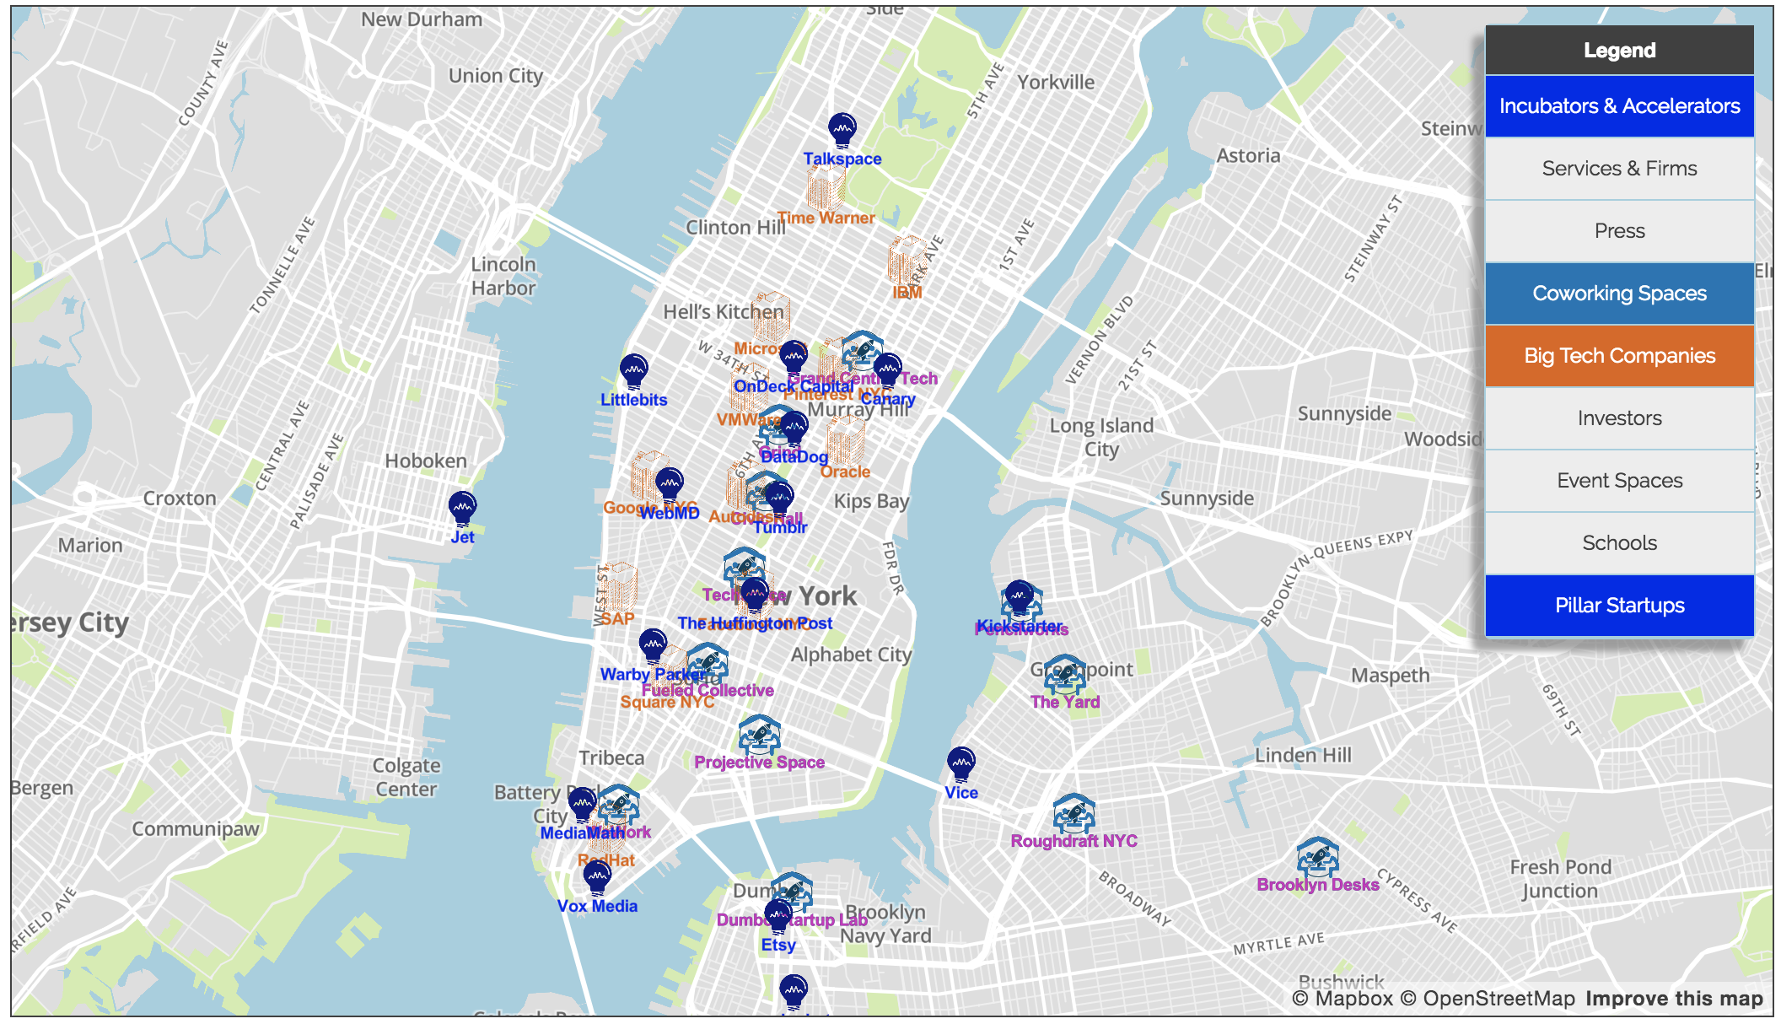
Tech Hubs
#3
34 Herald Sq
#7
42 St Port Auth
#6
86 St
#1
34 Penn St
#2
23 St
#8
Fulton St
#4
Grand Central-42 St
#5
Times Sq-42 St
#9
14 St-Union Sq
Map from: http://startupguide.nyc/
Notes:
EG

Slide 12
Combined Analysis
High Traffic Stations Demographic Highlights
34th Penn St Station High median household income ($159821)
23rd St Station High female population (60.7%), income ($135750)
and transit percentage (48.4%)
34th Herald Sq Near tech hubs
Times Sq 42nd St Station High transit percentage (37.2%)
Grand Central 42nd St Near tech hubs
Notes:
EG

Slide 13
Conclusion
Favorable trends for WTWY in Manhattan: easy to access traffic hubs also exhibit favorable demographics: high income, tech/business savvy and >50% female
Focus street team efforts on the key central hubs of Times Square and Penn Station:
Penn Station
Herald Square
Times Square
Grand Central
23rd Street
Notes:
BM

Slide 14
Next Steps
Further iron out any outliers
Analyze data for specific temporal trends
Demographic “scorecard” for each station
Notes:
Further iron out any outliers
Investigate March spike
Investigate different filter values
Analyze data for specific temporal trends: seasonal, weekday/weekend, time of day, etc to optimize street team success
Demographic “scorecard” for each station, weighting each key feature

Slide 15
Questions?

Slide 16
Executive Summary - Full
Tasked with optimizing WTWY street team placement for raising awareness of upcoming gala
Utilized NYC MTA and demographic data to perform analysis on areas with high traffic and favorable demographics
Findings identified major traffic hubs where placement of street teams would be optimal based on surrounding population
Recommended stations for mobilizing street teams include: Penn Station, Herald Square, Grand Central, Times Square and 23rd Street
Notes:
EG

Slide 17
Assumptions - Full
Street teams = can only commit modest headcount; must be efficient with placement of people
Therefore, we want to find key hubs with extensive traffic and favorable demographics to send our street teams
Approach: Analyse MTA subway data to identify the heaviest foot traffic, and then verify that the identified locations consist of sufficient amounts of favorable demographics
Gala in June 2017
Notes:
EG

Slide 18
Scenario
WTWY is looking to explore collaboration opportunities with our group
They are holding annual gala beginning of summer
Tasked with optimizing street team effectiveness by analyzing key areas of potential gala attendees and tech/brand ambassadors
Street teams collect email addresses; those who sign up sent free tickets to gala
Notes:
EG

Slide 19
Target Demographics
High income household (~> $150,000)
Tech savvy
High female population (~> 51%)
High % use the NYC subway

Slide 20
Top Station Demographics
Max female population: 34 St - Herald Sq and 23 St Station
Max median household income: 34 - Penn St Station and 23 St Station
Max population using subways: 23 St Station and Times Sq 42 St Station
Tech Hubs near: 34 St - Herald Sq and Grand Central
Fulton St and 14 St - Union Sq

Slide 21
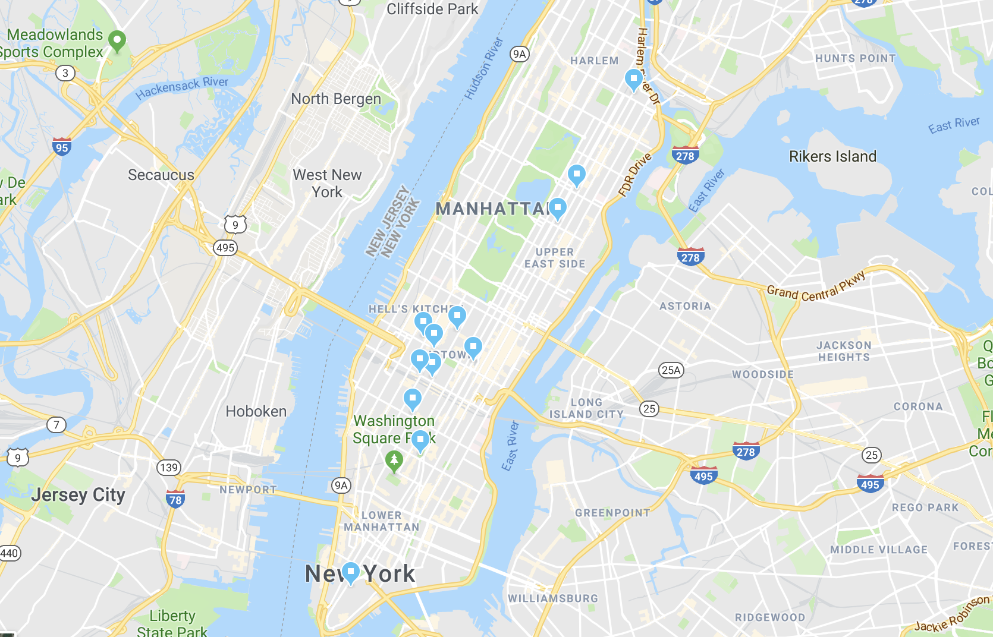
Top 10 Stations on Map
https://goo.gl/maps/pSYJLerh1vQ2
Notes:
BM

